Slide 1

Accent Detection App:
Classify English speech accents: American, British, Indian
Using Python, TensorFlow, Librosa, Streamlit
Presentation includes demo and future plans

Slide 2

Project Overview
Goal
Identify speaker accent from audio
Target Accents
American, British, Indian English
Applications
Call routing, language learning, content personalization
Performance
Target accuracy above 90%

Slide 3
Technology Stack
Python 3.9
TensorFlow/Keras
Librosa
Streamlit
Main programming language
Deep learning framework
Audio feature extraction
Web application interface
Supplemented by NumPy and Pandas for data handling

Slide 4
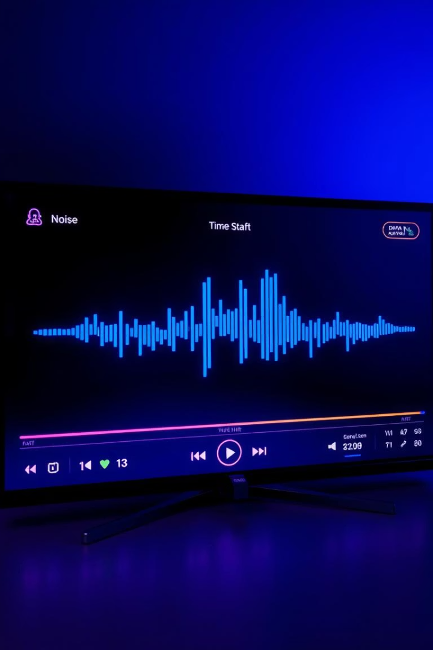
Data Collection and Preprocessing
Dataset
Augmentation
10,000 samples equally from 3 accents
Noise addition, time stretching, pitch shifting
Split
70% train, 15% validate, 15% test

Slide 5
Feature Extraction
MFCCs
Chroma
Spectral Contrast
Tonnetz
20 coefficients capture speech timbre
12 chroma values for pitch info
7 frequency bands show texture
Tonal centroid features for harmony
Features standardized to mean 0, std 1

Slide 6
Model Architecture
CNN Layers
1
3 convolutional layers, 2 max pooling
Dense Layers
2
2 fully connected layers
Activations
3
ReLU hidden, Softmax output
Training
4
Adam optimizer, 100 epochs, batch size 32

Slide 7
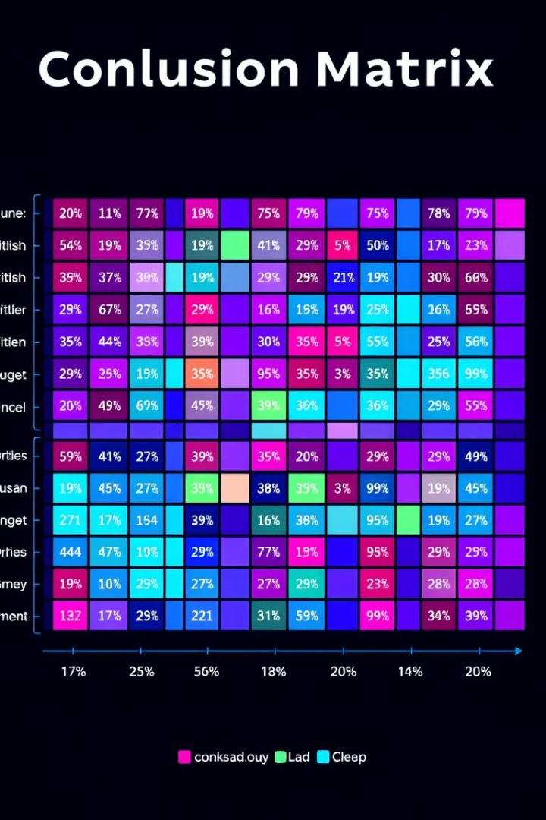
Results and Evaluation
Accuracy
Metrics
92% on test dataset
Precision, Recall, F1 >90% per accent
Benchmark
Outperforms SVM baseline models

